Slide 1

Introduction to Computing
Using Java
Event Handling

Slide 2
Michael Said…
GUI components are objects.
We set colour and size to them.
We add listener object(s) to them (Registration).
Listener objects
  are objects bearing certain “finger-print”;
  have methods to deal with the corresponding events.

Slide 3
Viable/ Feasible Listeners
They must be created from certain type of classes…
…those classes supporting (implementing) the XyzListener interface.
They have certain instance methods to deal with ALL possible actions of a listener
(see Table 11.1).
  e.g. MouseMotionListener defines
    mouseDragged()
    mouseMoved()

Slide 4
Extending an Adapter
XyzListener is an interface, in other words,
a set of expectations or requirements.
XyzAdapter classes fulfill the requirements.
We extend/ subclass the corresponding Adapter class.
Thus, objects created from such subclass are considered to be a XyzListener.

Slide 5
Example: Modifying an Adapter
We override some method(s) in the subclass:
  MouseMotionAdapter is a class which implements the MouseMotionListener interface.
  Extend (inherit) the class MouseMotionAdapter.
  Override the methods mouseDragged() and/or mouseMoved() to define our event handling behaviours.
  Create new object from the subclass and register the object as a listener to the appropriate components.

Slide 6
Listener Example
File ListenGUI.java
import java.awt.*;
import java.awt.event.*;
class ListenGUI {
public static void main(String[] args) {
Frame myWindow = new Frame();
myWindow.setTitle("Simple GUI");
myWindow.setSize(200, 100);
myWindow.setVisible(true);
MyWindowAdapter listenerObject = new MyWindowAdapter();
myWindow.addWindowListener(listenerObject);
// main finishes here BUT event dispatching loop picks up control
}
}
class MyWindowAdapter extends WindowAdapter {
public void windowClosing(WindowEvent e) {
System.out.println(“We can’t stop the program!”);
ListenGUI.main(null); // we may open other windows!!!
}
}

Slide 7
What Exactly is an Interface?
You see, we have two classes now: ListenGUI and MyWindowAdapter.
How can we combine them into one?
Interface mimics the effect of sharing
one or more sets of requirements.
  e.g. combining our class with MouseMotionListener
If a class implements an interface, we could be sure what fields/ methods (services) are provided.
→ Multiple Inheritance

Slide 8
Listener Example
File ListenGUI2.java
import java.awt.*;
import java.awt.event.*;
class ListenGUI2 implements MouseMotionListener {
public static void main(String[] args) {
Frame myWindow = new Frame();
myWindow.setTitle("Simple GUI");
myWindow.setSize(200, 100);
myWindow.setVisible(true);
myWindow.addMouseMotionListener(new ListenGUI2());
}
public void mouseDragged(MouseEvent e) {
System.out.print("Mouse dragged at ");
System.out.println("(" + e.getX() + ", " + e.getY() + ")");
}
public void mouseMoved(MouseEvent e) {
System.out.print("Mouse moved at ");
System.out.println("(" + e.getX() + ", " + e.getY() + ")");
}
}

Slide 9
Further Discussion
Interface and implements are OO topics.
GUI-wise, information sharing would be difficult if we do not implement an AWT interface.
  How could a handler/ callback method access fields/methods of other (component) classes?
  Be reminded that we are NOT the message sender.
  Real message sender is the event dispatching loop!

Slide 10

3-Minute Soft Break

Slide 11
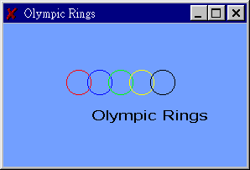
Remember Me?
Why do we normally extend a component?
import java.awt.*;
class Rings extends Frame {
public Rings ( ) { // constructor
setTitle ("Olympic Rings"); // the window title bar
}
public static void main (String [ ] args) {
Frame f = new Rings ();
f.setSize (300, 200); // window dimensions
f.setVisible (true); // show the window
}
public void paint (Graphics g) { // a method for painting
g.setColor(Color.red); g.drawOval( 80,80,30,30); // the rings
g.setColor(Color.blue); g.drawOval(105,80,30,30);
g.setColor(Color.green); g.drawOval(130,80,30,30);
g.setColor(Color.yellow); g.drawOval(155,80,30,30);
g.setColor(Color.black); g.drawOval(180,80,30,30);
g.drawString("Olympic Rings", 110,140); // the text
}
}
To override its methods, thus behaviour!

Slide 12

Layout and Placement
Frame object
Button object
Button object
Label object
TextField object

Slide 13
Layout Example
import java.awt.*;
import java.awt.event.*;
class NormalGUI extends Frame {
public NormalGUI() { // constructor
this.setLayout(new GridLayout(2, 2));
Button button1 = new Button("Button 1");
Button button2 = new Button("Button 2");
Label label1 = new Label("Name: ");
TextField text = new TextField();
this.add(button1); this.add(button2);
this.add(label1); this.add(text);
}
public static void main(String[] args) {
Frame myWindow = new NormalGUI();
myWindow.setTitle("Simple GUI");
myWindow.setVisible(true);
}
}

Slide 14

Layout Example
import java.awt.*;
import java.awt.event.*;
class NormalGUI extends Frame {
public NormalGUI() { // constructor
this.setLayout(new GridLayout(0, 3));
Button button1 = new Button("Button 1");
Button button2 = new Button("Button 2");
Label label1 = new Label("Name: ");
TextField text = new TextField();
this.add(button1); this.add(button2);
this.add(label1); this.add(text);
}
public static void main(String[] args) {
Frame myWindow = new NormalGUI();
myWindow.setTitle("Simple GUI");
myWindow.setVisible(true);
}
}

Slide 15
Layout Manager
There are several layout managers provided.
They are responsible for placing the child-components in an organized manner.
  GridLayout
  GridBagLayout
  BorderLayout…
We may give preference and constraints.
Usage is simple: create a layout object and use the setLayout() method of a component.

Slide 16
Add Children to a Component
Create the parent component.
Create the child component(s).
Send message to the add() method of the parent component in sequence.
The children will be added one-by-one.
Children placement is determined by the layout manager of the parent component.

Slide 17
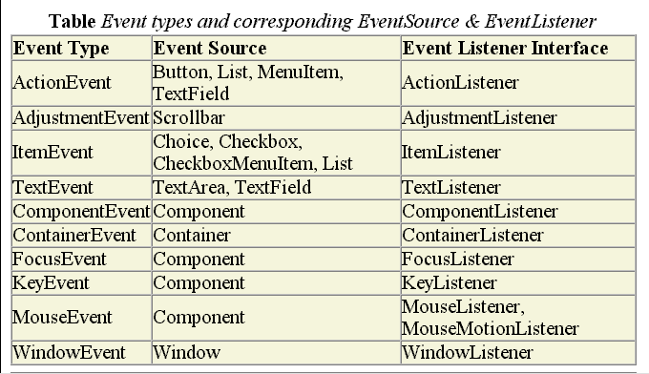
Appendix

Slide 18
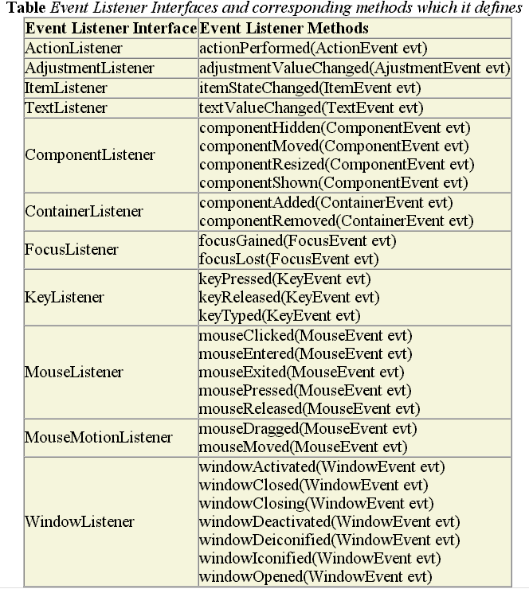
Con’d

Slide 19
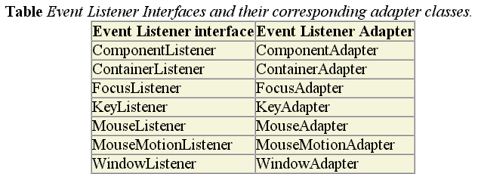
Con’d

Slide 20
Interesting Topics
Using Canvas
  Creating custom 2D graphics
  Painting

Slide 21
End Note
Readings and References
  Sections 3.9, 3.10: Components
  Sections 4.6, 4.7, 4.8: GUI, Buttons
  Section 5.10: Events
  Section 6.10: GUI Design
  Sections 7.9, 7.10: More events
  Section 8.6: Component Class Hierarchy
  Section 8.7: Extending Adapter Classes

